Slide 1

Project 145 Resume Classification.
Project Guide :- Mr. Advaith Reddy.
Mrs. Roshani Yuvraj Katkar.
Mr. Shaik Irfan (R).
Miss Bindiya Anil Chavan.
Mr. Aniket Manohar More.
Mr.Gaurav Gupta.
Mr. Deepak Anil Shimpi.
Mr. G. Naveen Kumar.

Slide 2
Objective
The main objective of Natural Language Processing (NLP)-based Resume Parser in Python project is to extract the required information about candidates without having to go through each and every resume manually, which ultimately leads to a more time and energy-efficient process.

Slide 3
Introduction
Due to the high number of applicants and resumes submissions to job postings, manual resumes screening processes become tedious, ineffective and time consuming for talent acquisition professionals. Therefore, standardized automated screening methods are necessary to categorize qualified from unqualified candidates based on their background, education and professional experience faster, with more efficiency and more accurate results to streamline hiring processes.

Slide 4
Primary goal.
To extract skill set and qualification from given document.
To build the best model which gives the maximum performance, and need to deploy the model with either RShiny or Flask/ stream lit

Slide 5
Project Flow Chart.
Text extraction
Text preprocessing
Visualization
Model building
Model evaluation
Deployment
Resume

Slide 6
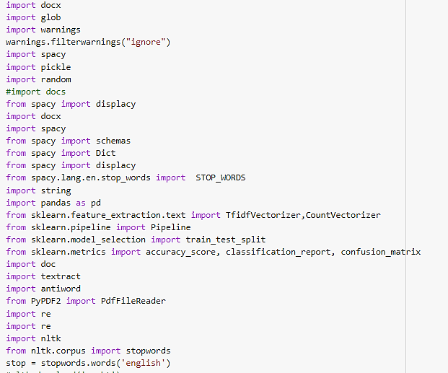
Imported libraries

Slide 7
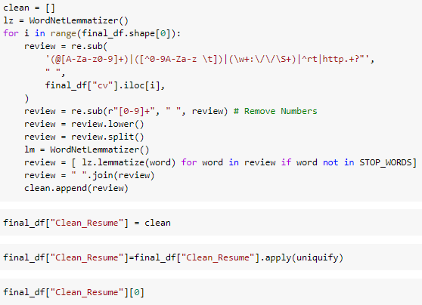
We extracted the text from all folders of job types by using following Algorithm.
directory = '/content/drive/MyDrive/Total Resumes/ReactDev'
for i in os.listdir(directory):
if i.endswith('.docx') or i.endswith('.doc') or i.endswith('.pdf'):
os.path.join(directory, i)
file_path.append((textract.process(os.path.join(directory, i))).decode('utf-8'))
Text Pre-processing.
After extracting the text from given data, it need to be cleaned.
Following are few steps for data cleaning.
Removing stop words
Removing punctuations.
Converting to lower case.

Slide 8
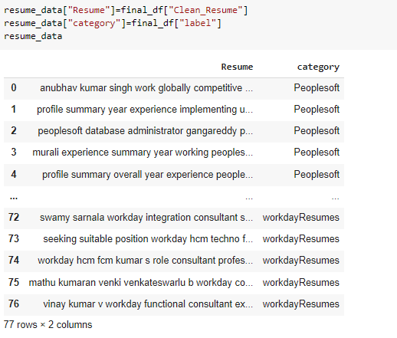
Cleaned Dataset.

Slide 9
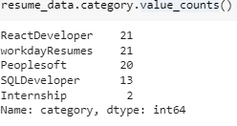
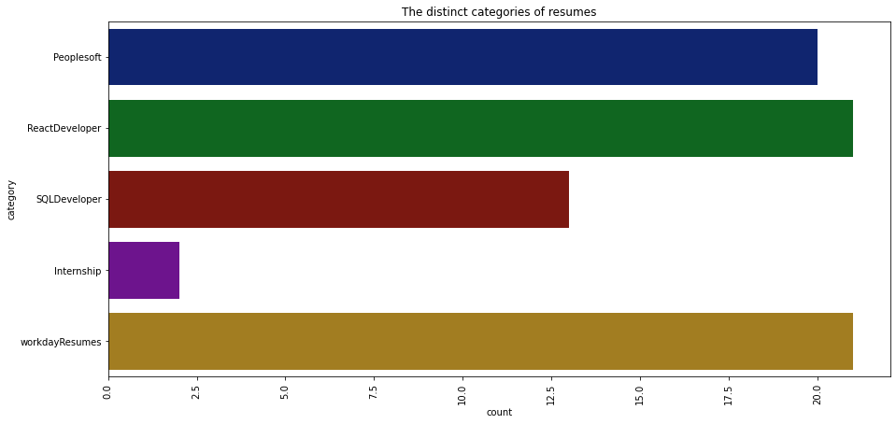
Categories

Slide 10
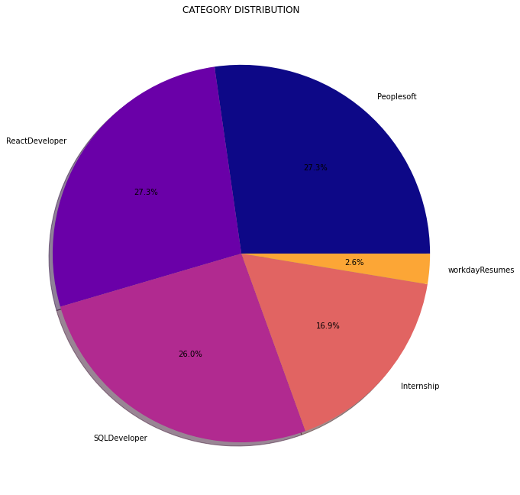
Categories

Slide 11
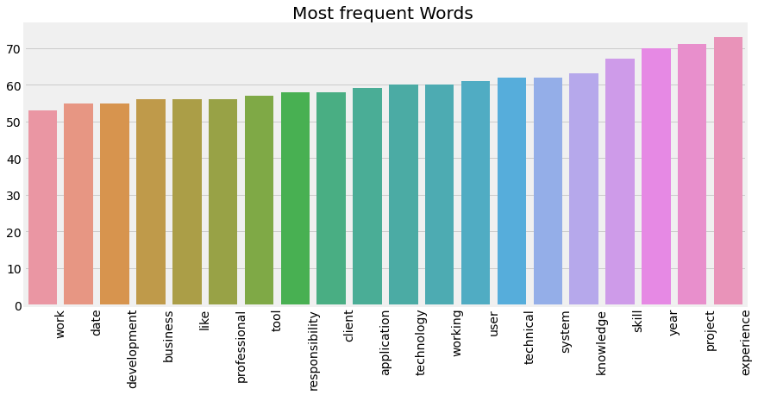
Most Frequent Words.

Slide 12
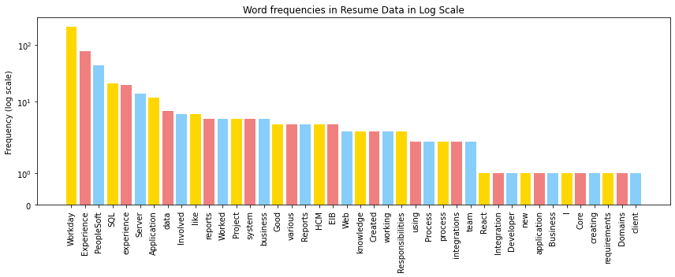
Most Frequent Words.

Slide 13
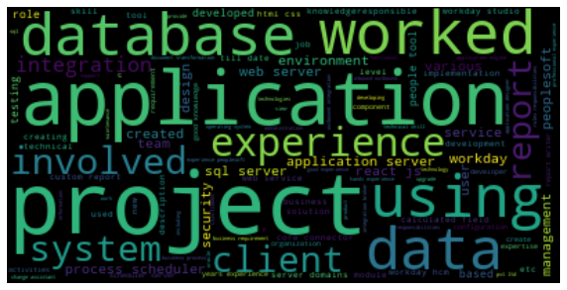
Wordcloud.

Slide 14
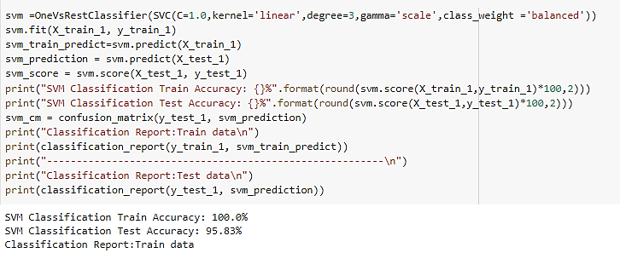
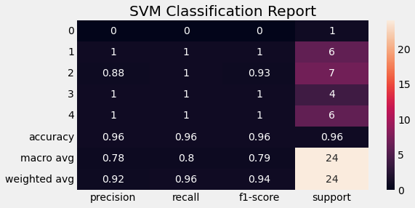
SVM Classifier results.

Slide 15
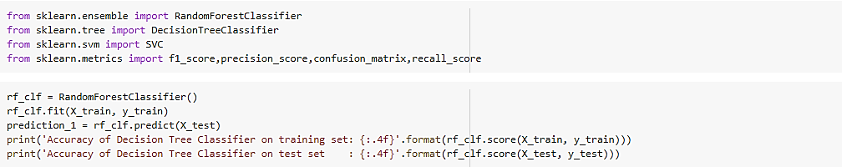
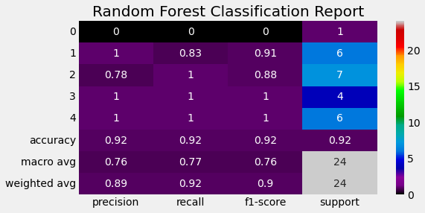
Random Forest Classifier results.

Slide 16
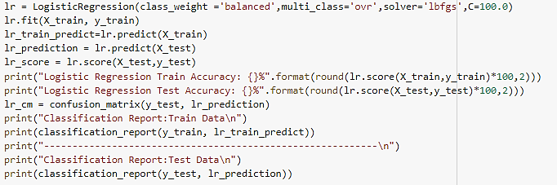
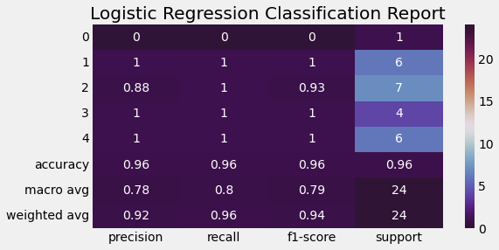
Logistic Regression Classifier results.

Slide 17
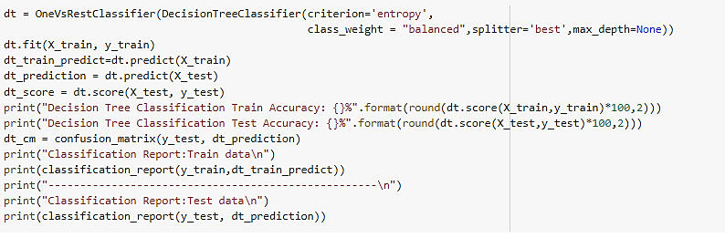
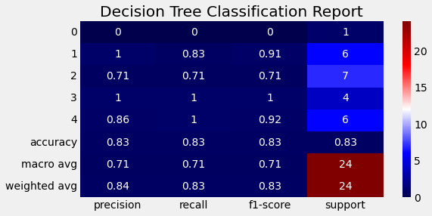
Decision Tree Classifier results.

Slide 18
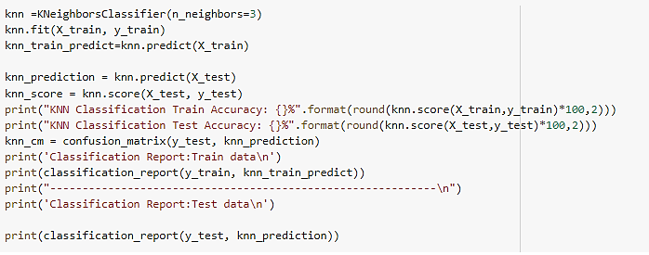
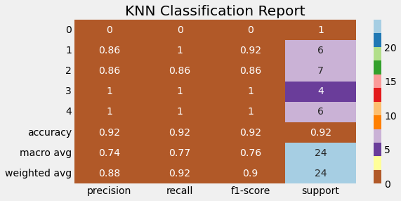
KNN Classifier results.

Slide 19
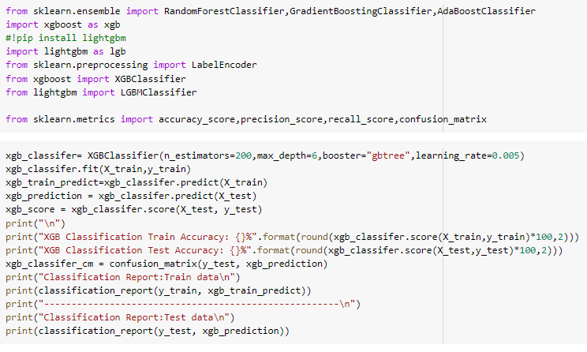
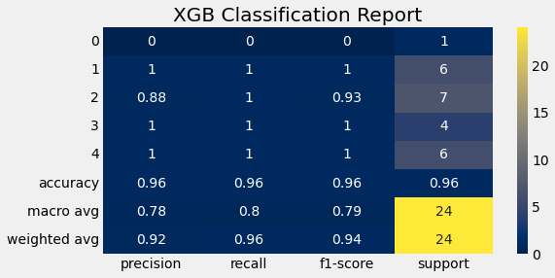
XG Boost Classifier results.

Slide 20
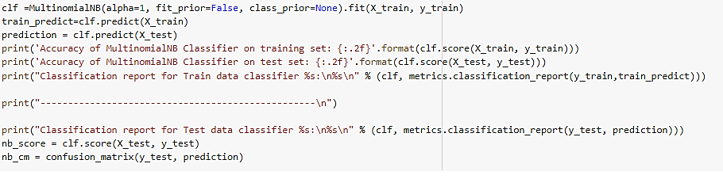
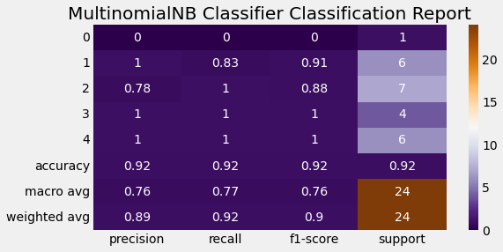
Multinomial Classifier results.

Slide 21
Accuracy score of all Classifier models.

Slide 22
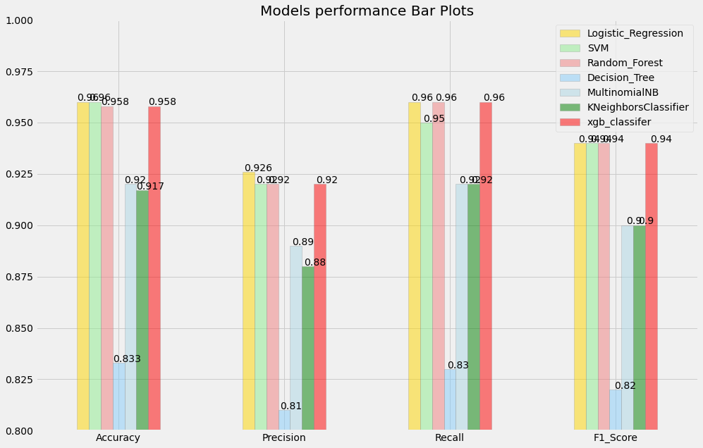
Accuracy score of all Classifier models.

Slide 23
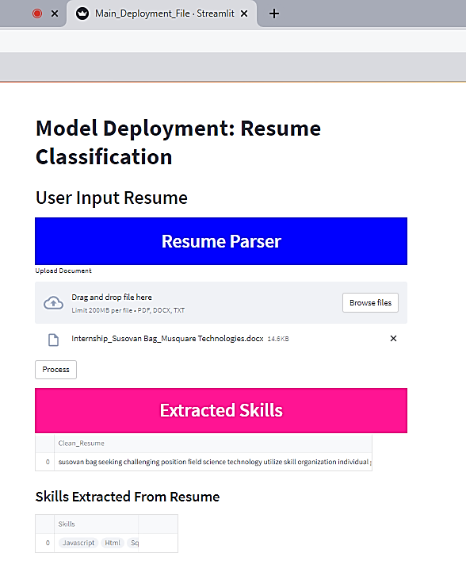
Deployment
Deployment has performed using Streamlit.
When resume is added to model, it will extract the data from resume.
Algorithm will process the extracted data, which is further fitted to the model.
Model will give skills and plain text as output.
Recruiter can match those keywords to Specific job profile, & able to select right candidate.

Slide 24
Challenges faced during this project & Future scope of the project.
The major limitation and challenge for the Resume Classification and Recommendation task is finding an appropriate and standard dataset to process using the NLP techniques and train the ML models.
Since the resume is not a standard document and there is no specific industry standard, thus major efforts were put on processing the documents in the dataset which were parsed from different formats and layouts. Moreover, the dataset size was a bit low to train the ML model for generalized classification. However, efforts were put to find a more suitable dataset for the classification task.
The study achieved significant accuracy and performance gain on Resume Classification in different job categories. Therefore, in future work, the model will be extended to match the content of the resume with the provided job description.
The extension in future work will enable the proposed system suitable for the complete recruiting process. The proposed system will perform the most tedious tasks of recruiting process; categorization and recommendation of suitable resumes for a given job description.

Slide 25
Summary
Technology is making the job search process easier and harder. Larger pools of applicants and limited opportunities force candidates to write outstanding resumes capable of defeating the “bots”. It is highly recommended for candidates to optimize their resumes keywords to represent their soft and hard skills and avoid including buzzwords.
In this project, we learned how machine learning and Natural Language Processing can be applied to improve our day-to-day life through the example of Resume Screening. We just classified our resumes in few minutes into their respective categories with almost 99% accuracy.

Slide 26
Thank you !

